Slide 2
Monitoring of Human Health Condition With Mobile Device
Radiations
Using IOT
By:
Shikha Shah
001688235

Slide 3
Contents:
Problem Statement
Objective
Object Model
Key Roles
Key Features
Extra-Features

Slide 4
Problem Statement:
With rise in usage of electronics devices and wireless technology, it is becoming essential to detect its effects on the human health and finding the viable alternative to it.
With increase usage of cellular phones it is becoming essential to detect its effects on the human health and finding the viable solution to it.

Slide 5
Objective:
To increase the health index of the people at global scale by giving them appropriate safety and protection measures against radiofrequency electromagnetic fields.

Slide 6
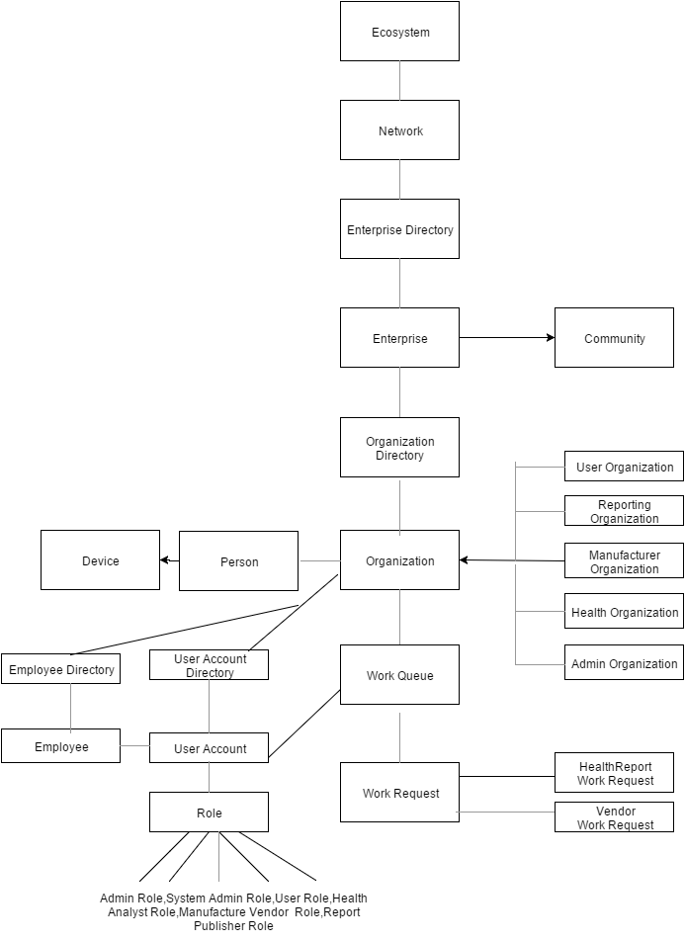
Object Model

Slide 7
Thank You

